Slide 1
HSAemu
NTHU HSA Course

Slide 2
Review Virtual Machines

Slide 3
VM overview
Why do we prefer something virtual than real?
  Why Virtual memory?
  Why Java Virtual Machine?
  Why Virtual I/O?
  Why Virtual Private Network (VPN) ?

Slide 4
VM overview
Why Virtual Memory?
  Sharing, protection, large address space, …
Why Java virtual machine?
  Interoperability, application sharing, protection,
Why Virtual I/O?
  NIC: flexibility, low cost sharing, better management
  Disk storage: disk expansion and shrinking
Why Virtual Private Network (VPN) ?
  Secure communication over unsecure (public) network
  QoS – bandwidth guarantee

Slide 5
Virtual is better than Real
So virtualization is often related to the following:
  Resource Sharing
  Protection, Security, Safety
  Flexibility
  Interoperability, Platform Independence
  Portability
  Emulation

Slide 6
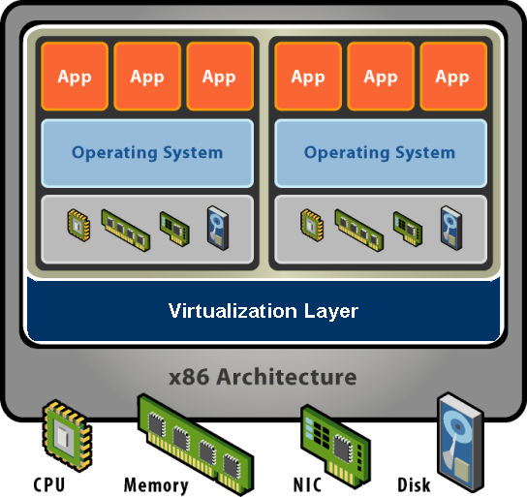
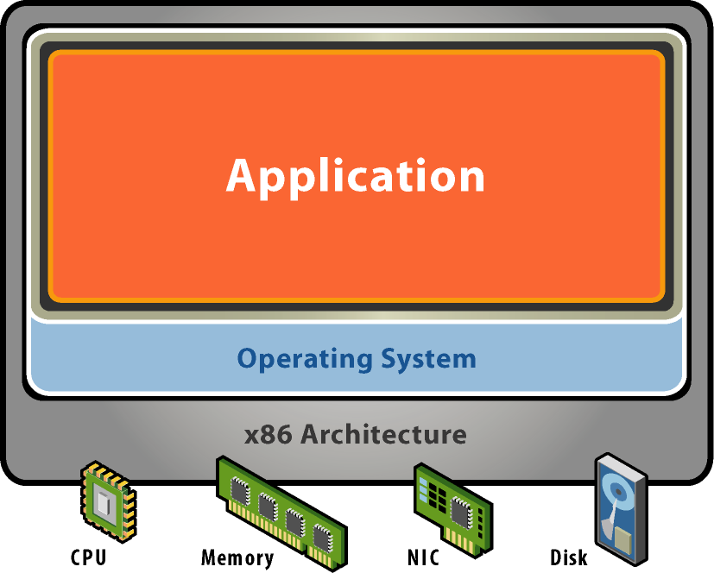
Virtualization
Process virtualization: language level (Java, .Net) OS-level (Solaris Zone), Cross-ISA (Apple Rosetta, IA32EL, FX!32)
Device virtualization: VLAN, VPN, RAID
System virtualization: VMware ESX, Xen, KVM, MS Hyper-V, OKL4 Microvisor

Slide 7
VM overview
Why are virtual machines interesting?
  They allow transcending of standard interfaces (which often seem to be an obstacle to innovation)
  They enable innovation in flexible, adaptive software & hardware, security, network computing (and others)
  They involve computer architecture in a pure sense

Slide 8
Transcending of standard interfaces
Well-defined interfaces allow design tasks to be decoupled, e.g. ISA, system calls, API
  Examples: IA-32 (x86) ISA, Linux, OpenGL
  Such interfaces can also be confining: subsystems and components designed to specification for one interface will not work with those designed for another.
  Examples: x86 binary does not run on PowerPC, Linux based apps do not run on Windows
Diversity in ISA, OS, and PL lead to innovations. However, it also leads to reduced interoperability.
  The trend of ISA consolidation, for example, limits innovations in computer architectures.

Slide 9
Enable innovation in flexible, adaptive software & hardware, security, network computing
Many OS are developed for a specific system architecture and are designed to manage hardware resources directly. This limits the flexibility of the system, in terms of available application software, security and failure isolation.
Example:
  Can you run iPhone’s applications on Gphone?
  One rogue application could crash a complete system
  Virus, worms, and malicious attacks

Slide 10
VM overview
Virtual machines have been investigated and built by
  OS IBM VM/CMS,VmWare, Xen
  Language designers JVM, P-code
  Compiler developers MS .Net/CIL, Dynamo, Aries
  Hardware designers Crusoe, Intel VT, AMD-V, ARM virtualization extension (hyp mode + others)
This course tries to look at underlying concepts and technologies that are common across the spectrum of virtual machines
This is a cross-disciplinary (inter-disciplinary) course!

Slide 11
VM overview
Virtualization will be a key part of future computer systems
  Due to the network computing environment
  A fourth major discipline? (with HW, System SW, Application SW)

Slide 12
Abstraction
Computer systems are built on levels of abstraction
Higher level of abstraction hide details at lower levels
Example: files are abstraction of a disk

Slide 13
Machines (defined by ISA)
For OS developers, a machine is defined by ISA (Instruction Set Architecture)
Major division between Hardware and software

Slide 14
Machines (defined by ABI)
For Compiler developers, a machine is defined by ABI (Application Binary Interface)
ABI
User level ISA + OS System Calls

Slide 15
Machines (defined by API)
For Application developers, a machine is defined by API (Application Programming Interface)
API
User level ISA + Library Calls (such as Clib, OpenGL)

Slide 16
Virtual Machines
Add Virtualizing Software to a Host platform and support Guest process or system on a Virtual Machine (VM)

Slide 17
Process Virtual Machines
Execute applications with an ISA different from the HW platform
Couple at ABI level via runtime system
Usually not persistent

Slide 18
Process Virtual Machines
Guest processes may intermingle with host processes
As a practical matter, guest OS and host OS are often the same
Example: IA-32 EL, FX!32, Aries, Rosetta
Same ISA dynamic optimizer is a special case
Example: Dynamo, Adore
Dynamic binary instrumentation
Example: PIN, Valgrind, DynamoRIO

Slide 19
Cross-Platform Portability
PowPC
programs
x86 programs
x86-32 programs
HP –PA
programs
Rosetta
(Apple)
FX!32
(DEC)
IA-32EL
(Intel)
Aries
(HP)
x86-32
or x86-64
DEC
Alpha
IA-64
(Itanium)
IA-64
(Itanium)

Slide 20
Crossa-Platform Portability
x86 programs
ARM
FX!32
Virtual PC
IA-32EL
DEC
Alpha
IA-64
(Itanium)
Sun
Sparc
ARM
PowerPC
Is there a way to make it more portable?

Slide 21
HLL Virtual Machines
Java and MS CLI (Common Language Infrastructure) are current examples
Binary class files are distributed
“ISA” is part of binary class format
OS interaction via API (part of VM platform)

Slide 22
Another Possibility
x86 programs
C
LLVM IR
Byte
code
LLBT
DEC
Alpha
IA-64
PowerPC
Sun
Sparc
ARM

Slide 23
System Virtual Machines
Provide a system environment
Constructed at ISA level
Allow multiple OS environments, or support time sharing.
Examples: IBM VM/360, VMware, Xen KVM, OKL4
Virtual network communication

Slide 24
System Virtual Machines
Windows Apps
Linux Apps
MS Windows
Linux
VMM or Hypervisor
IA-32 Physical Machine

Slide 25
Hosted System VMs
Virtualization SW is built on top of an existing OS
Installation process is similar to the installation of an APP
Let the host OS to provide device drivers and other low-level services
Linux Apps
Windows Apps
MS Windows
Linux
IA-32 Physical Machine

Slide 26
System Virtual Machines
Past: Early IBM VMs
  Large main frames are shared by many groups, and each group may want different OS
  As a convenient way to implement time sharing OS for multiple single user OS
Current:
  Server consolidation
  Secure partitioning
  Multiple OS environments
  Fault isolation
  Support software development and deployment
  Cloud computing

Slide 27
Co-designed Virtual Machines
Perform both translation and optimization
VM provides interface between standard ISA software and implementation ISA software
Primary goal is performance or power efficiency
Use proprietary implementation ISA
Example: Transmeta Crusoe and IBM Daisy

Slide 28
Taxonomy
Pin, Valgrind

Slide 29
GPU Virtualization
Enable GPU to be shared by multiple graphics applications
  More like system VM, or server virtualization
Graphics VISA (Virtual-ISA)
  Graphics applications are translated into IR (Intermediate Representations) such as PTX (Parallel Thread Execution) or HSAIL (Heterogeneous Systems Architecture Intermediate Language). At runtime, such IR code can be translated for the underlying graphics devices.
  More like HLL VM

Slide 30
Review Virtualization Technology

Slide 31
Common terms
Guest and Host
  Guest: Environment that is being supported by underlying platform
  Host: Underlying platform that provides guest environment
  Example: Emulating a Android(ARM) on PC(Intel), Android is the Guest, PC is the Host
Ways of implementing emulation
  Interpretation: instructions at-a-time
  Binary Translation: block-at-a-time optimized for repeated instruction executions. (block could be a trace, or even a procedure)

Slide 32
Interpretation
Source ISA and Target ISA
  Source ISA: Original instruction set or binary
  Target ISA: Instruction set being executed by processor
  Source/Target refer to ISAs; Guest/Host refer to platforms
Hold complete source architecture state in the interpreter’s data memory
Architecture State
Program counter
Code
Condition codes
Register 0
Data
Interpreter Code
Register 1
……..
Stack
Register N

Slide 33
Decode-Dispatch Interpretation
while (!halt && !interrupt)
{
inst = code (PC);
opcode = extract (inst, 31, 6);
switch (opcode) {
case LoadWord: LoadWord (inst);
case ALU: ALU (inst);
case Branch: Branch (inst);
. . .
}
LoadWord(inst)
{
RT = extract (inst,25,5);
RA = extract (inst,20,5);
offset = extract (inst,15,16);
source = regs[RA];
address = source + offset ;
regs[RT] = data[address];
PC = PC + 4;
}
Source
ISA
code
PC

Slide 34
Decode-Dispatch: Low efficiency
Executing an instruction
  Approximately 20 target instructions
  Several loads/stores
  Several shift and mask steps

Slide 35
Binary Translation
Generate custom code for every source instruction. For example, a load instruction in source code could be translated into a respective load instruction in native code.
Get rid of repeated parsing, decoding, and jumping overhead.
Compiled emulation is an early form of binary translation.
PowerPC Target
addi r16,r4,4 ; add 4 to %eax, r16=r4+4
lwzx r17,r2,r16 ; load operand from memory
add r7,r17,r7 ; perform add of %edx
stwx r7,r2,r16 ; store %edx into memory
mr r4,r16 ; move update value into %eax
addi r3,r3,9 ;
x86 Source Binary
addl %edx,4(%eax)
movl 4(%eax),%edx
add %eax,4

Slide 36
Dynamic Translation
First Interpret
  And perform code discovery as a byproduct
Translate Code
  Place translated blocks into Code Cache
  Save source PC to target PC mapping in an Address Lookup Table
Emulation process
  Execute translated block to end, Lookup next source PC in table. If translated, jump to target PC, else interpret and translate

Slide 37
Dynamic Translation
Source Binary
SPC to TPC
Look-up Table
1
2
Emulation
Manager
4
Translator
5
3
miss
Code cache
6
Interpreter
hit

Slide 38
Flow of Control
Control flows between translated block and emulation manager
Translation Block
Emulation
Manager
Translation Block
Translation Block
Context switch

Slide 39
Translation Chaining
Jump from one translation directly to next. Avoid switching back to emulation manager
Translation Block
Emulation
Manager
Translation Block
Translation Block
Translation Block

Slide 40
Review QEMU

Slide 41
QEMU Overview
QEMU - Quick EMUlator
Processor emulator relies on Binary translation Using a Tiny Code Generator(TCG)
Free and open source
KVM support
Support process VM and system VM
Support same ISA and cross ISA emulation
  This slide focuses on system VM and cross ISA emulation

Slide 42
Basic Background: POSIX thread
mutual exclusion lock/unlock
  If current thread already has mutex, than lock same mutex again. It will cause dead lock condition
  If current thread does not have mutex but unlock it which is very dangerous
condition wait
  Before use condition wait, current thread must have mutex already
  When current thread use condition wait, it will unlock mutex first, then wait until another thread signals it
  If current thread wake up, it must get the mutex again before execute codes
condition signal/broadcast
  Condition signal will wake 1 thread up at random
  Before use condition broadcast, make sure all of thread (which should be waiting) already in waiting state

Slide 43
QEMU Main Control Flow
QEMU only create 1 thread which be called “vCPU thread”to represent vCPUs (no matter how many vCPU) and main thread finally becomes“IO thread”
QEMU use global mutex lock to achieve vCPUs and IO communication
vCPU thread execute TCG in the infinite loop
IO thread wait IO and execute IO in the infinite loop
When IO happened, vCPU thread must stop until IO thread finish job

Slide 44
QEMU TCG
Tiny Code Generator
  A generic backend for a C compiler. It was simplified to be used in QEMU
Translation Block(TB)
  A TCG "basic block" corresponds to a list of instructions terminated by a branch instruction
Prologue/Epilogue
  Load/store all vCPU registers in stack
TB use page as unit to be maintained
(guest physic page)
prologue
Code cache
CPU_EXEC
TB
epilogue
TB

Slide 45
TCG Intermediate Representations
Intermediate Representation is Virtual-ISA, like LLVM IR, PTX(Parallel Thread Execution). At runtime, such IR code can be translated
Source ISA
DEC Alpha | IA-64 | IBM PowerPC | Sun Sparc | ARM | x86
TCG IR
Target ISA
DEC Alpha | IA-64 | IBM PowerPC | Sun Sparc | ARM | x86

Slide 46
Execution flow
CPU_EXEC
Find_fast
Not found
Find_slow
Using current virtual PC
Search in a cached hash table
found
Using current phy-addr
Search in a hash table
found
Not found
Exec
Gen_code
Unlink the TB when CPU need to stop
Tb_link
Chain the TB

Slide 47
Exception and interrupt
CPU_EXEC
Find_fast
Not found
Find_slow
TB1
found
found
Not found
TB2
Exception or
Interrupt
exec
Gen_code
TB3
Tb_link
TB4

Slide 48
Code block Chaining
struct TranslationBlock {
struct TranslationBlock *jmp_next[2];
struct TranslationBlock *jmp_first;
};
jmp_next[0]
jmp_next[1]
jmp_first
QEMU uses the last two bits of the pointer to TranslationBlock to encode
the direction of block chaining:
  0 -> branch taken
  1 -> branch not taken
  2 -> EOF

Slide 49
Example (insert)
TB1
TB3
TB1 -> jmp_next = TB2 | 2
TB2 -> jmp_first = TB1 | 0
TB3 -> jmp_next = TB2->jmp_first = TB1 | 0
TB2
TB2 -> jmp_first = TB3 | 0
struct TranslationBlock
QEMU code cache

Slide 50
Example (remove)
TB1
jmp_next = TB1 | 0
TB3
jmp_next = NULL
jmp_next = TB2 | 2
jmp_first = TB1 | 0
TB2
jmp_first = TB3 | 0
struct TranslationBlock
QEMU code cache

Slide 51
Example (remove)
TB1
TB3
jmp_next = NULL
jmp_next = TB2 | 2
jmp_first = TB1 | 0
TB2
struct TranslationBlock
QEMU code cache

Slide 52
Address
Guest Virtual Address (GVA)
Guest Physic Address (GPA)
Host Virtual Address (HVA)
Host Physic Address (HPA)
GVA
GPA
offset
HVA
HPA
guest OS+softmmu
host OS+HW

Slide 53
HSAemu Introduction

Slide 54
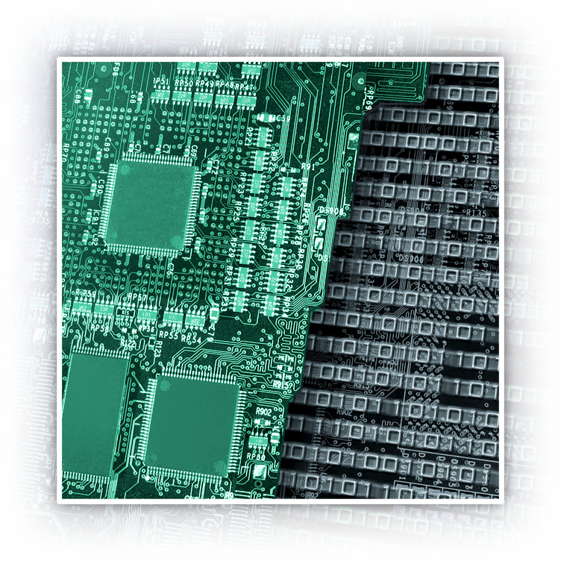
What Is HSAemu
HSAemu is a full system emulator that supports the following HSA features
  Shared virtual memory between CPU and GPU
  Memory based signaling and synchronization
  Multiple user level command queues
  Preemptive GPU context switching
  Concurrent execution of CPU threads and GPU threads
  HSA runtime
  Finalizer
A Project Sponsored by MediaTek (MTK)
Currently, it supports simple HSA platform simulation
  Functional-accurate simulation
  Cycle-accurate simulation

Slide 55
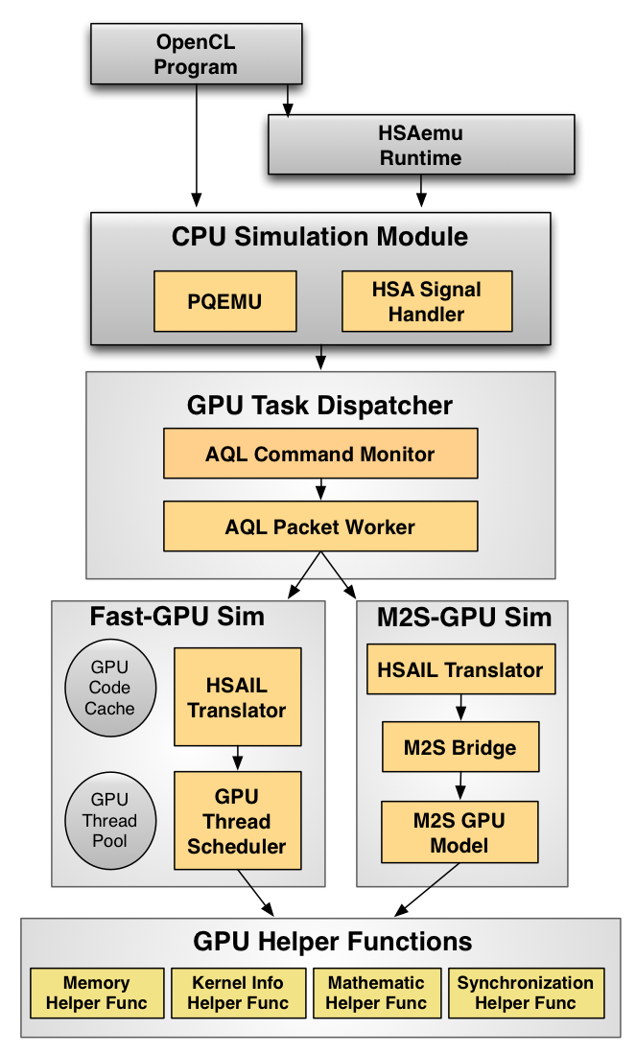
Architecture of HSAemu
HSAemu consists of 6 components
  HSA Runtime
  CPU Simulation Module
  GPU Task Dispatcher
  Functional-Accurate GPU Simulator (Fast-GPU Simulator)
  Cycle-Accurate GPU Simulator (Mult2sim)
  GPU Helper Functions

Slide 56

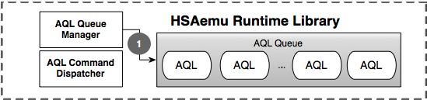
HSAemu Runtime
User Mode Queue
  Store AQL packets
AQL Queue Manager
  Manage AQL packets in User Mode Queue
AQL Command Dispatcher
  Launch the execution of kernel jobs on HSAemu
Support OpenCL runtime

Slide 57
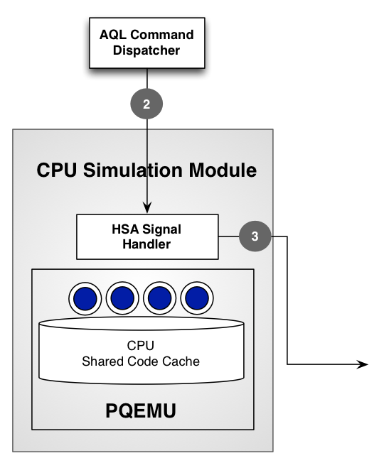
CPU Simulation Module (1)
PQEMU – Perform multicore CPU simulation
HSA Signal Handler – Receive AQL command from HSA Runtime and launch GPU simulation

Slide 58
CPU Simulation Module (2)
PQEMU
  A parallel system emulator based on QEMU
  Tow efficient synchronization models (UCC/SCC)
  Dynamic binary translation (DBT) technique
  A project sponsored by MTK
Agent code, HSA runtime, and operating system are run on PQEMU
Code Cache
DBT
DBT
DBT
DBT
CPU
CPU
CPU
CPU
Unified Code Cache (UCC) Model
“PQEMU: A Parallel System Emulator Based on QEMU” (ICPADS 2011)

Slide 59
GPU Task Dispatcher (1)
AQL Command Monitor
  Receive signal from HSA Signal Handler
  Copy AQL packets from User Mode Queue to HW AQL Queue
  Launch AQL Packet Worker
AQL Packet Worker
  Dequeue AQL packets from HW AQL Queue
  Parse AQL packet
  Dispatch kernel jobs to Fast-GPU Simulator or M2S-GPU Simulator according to the kernel information

Slide 60
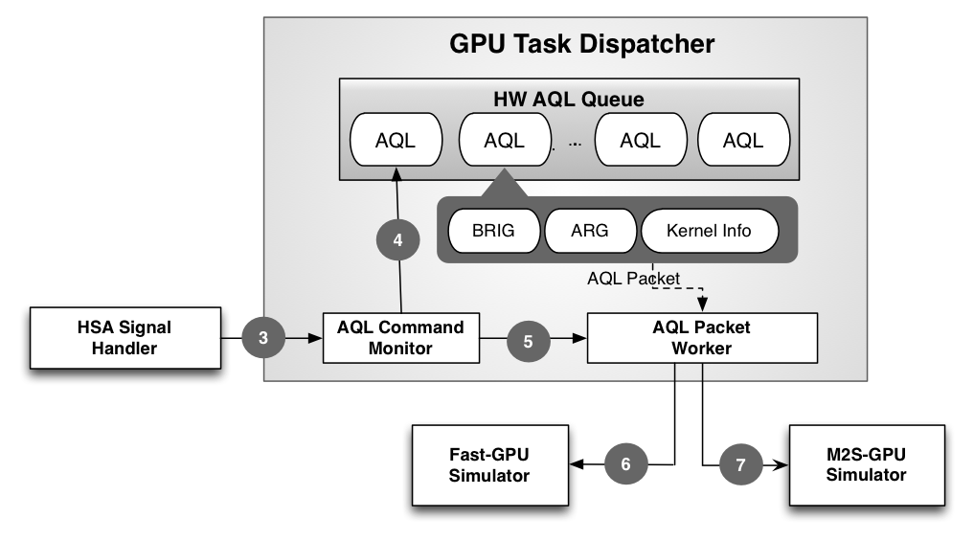
GPU Task Dispatcher (2)
Execution Flow
Signal from
HSA Signal Handler
Launch
AQL Packet Worker
to Parse AQL Packet
Launch Fast-GPU
Simulator
Launch M2S-GPU
Simulator
Copy AQL Packets from
User Mode Queue to
HW AQL Queue

Slide 61
Fast-GPU Simulator
A functional-accurate simulator for generic GPU model simulation
  HSAIL Translator
    Act as a Finalizer
    Use static binary translation technique to translate BRIG file to host executable binary file (x86) based on LLVM
    Host SSE instruction optimization
  GPU Thread Scheduler
    Simulate a generic GPU model

Slide 62
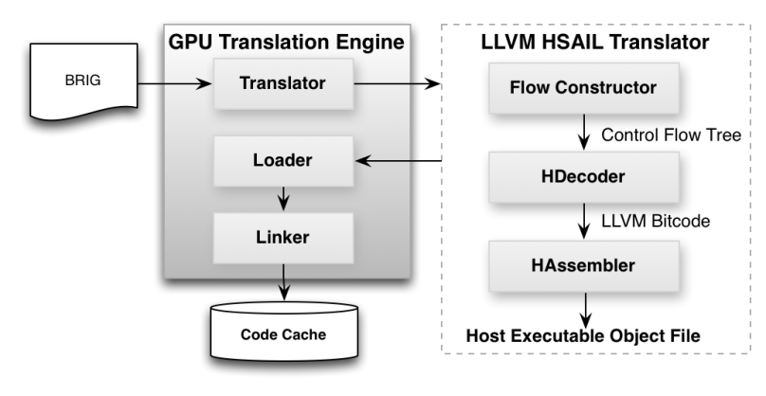
HSAIL Translator
Architecture of HSAIL Translator
Translate LLVM IR
to Host Executable
Object File (x86)
Read BRIG File And
Launch LLVM
HSAIL Translator
Construct
The Control Flow
Graph of HSAIL
Program
Store The Host Executable
Binary to GPU Code Cache
Load Host Executable
Object File
Translate HSAIL
To LLVM IR
Link to GPU
Helper Functions

Slide 63
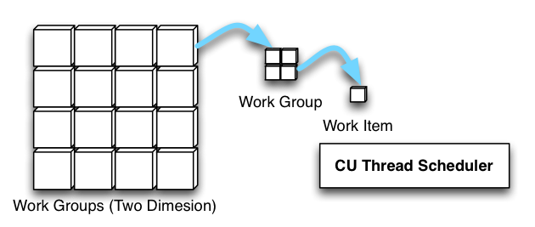
GPU Thread Scheduler
Simulate a generic GPU model
  GPU Thread Scheduler assigns work groups to free CU threads in the GPU Thread Pool
  Each CU thread executes all work items in a work group
  The maximum number of CU threads is limited by host operating system

Slide 64
M2S-GPU Simulator (1)
A cycle-accurate simulator for AMD Southern Islands GPU model simulation
  HSAIL Translator
    Translate BRIG file to GPU binary
  M2S Bridge
    Bridge Multi2Sim GPU Model to HSAemu
  M2S GPU Module
    Simulate a cycle-accurate GPU model

Slide 65
M2S-GPU Simulator (2)
HSAIL Translator
  Act as a Finalizer
  Translate HSAIL to AMD Southern Islands GPU binary (under development)
  Use static binary translation technique based on LLVM

Slide 66
M2S-GPU Simulator (3)
M2S Bridge : An interface to launch M2S GPU Module
  Initialize the data structures used by AMD Southern Islands GPU, including a memory register for AMD Southern Islands GPU to access the shared system memory in HSAemu
  Invoke M2S GPU Module (the AMD Southern Islands GPU module in Multi2Sim)

Slide 67
M2S-GPU Simulator (4)
M2S GPU Module
  A cycle-accurate AMD Southern Islands GPU simulator in Multi2Sim
Memory access is performed by HSAemu memory helper function to comply the hUMA model

Slide 68
GPU Helper Functions (1)
Memory Helper Function
  A soft-mmu of GPU with a page table worker and a TLB to enable hUMA model
  Support the redirect access of a local segment memory to a non-shared private memory in GPU
Kernel Information Helper Function
  Collect and return information of GPU simulation and current execution state
  Retrieve kernel information such as working item ID, work group size, etc, from AQL packet

Slide 69
GPU Helper Functions (2)
Mathematic Helper Function
  Simulate special mathematical instructions such as trigonometric instructions by calling the corresponding mathematical functions in standard library
Synchronization Helper Function
  Barrier synchronization implementation for generic GPU model simulation

Slide 70
hUMA Model in HSAemu
Unified coherent address space
  GPU can access a virtual memory page allocated by CPU
Soft-mmu is simulated for GPU
  TLB hit/miss events can be traced
Memory segment access
  Global memory segment access is handled by memory helper function
  Group memory segment access is handled by host ld/st instructions

Slide 71
Recall: Hardware Simulation of HSAemu
HSA hardware components simulated
  Multicore CPU: A parallel multicore CPU model simulation
  Functional-Accrate GPU: A generic GPU model simulation
  Cycle-Accurate GPU: AMD Southern Islands GPU model simulation
  hUMA: A unified address space between CPU and GPU simulation
  Synchronization Primitive: Barrier instruction simulation
  Hardware AQL Queue: A HW dispatch queue for GPU simulation

Slide 72
Recall: Software Utilities of HSAemu
HSA software utilities designed
  HAS Runtime: HSA runtime library (OpenCL runtime)
  Topology Discovery: Discover the current platform topology
  User Mode Queue: A queue for each user application
  Signal Event: Notify GPU to work
  HSAIL Generator: A PTX to HSAIL source level translator
  BRIG Generator: Generate a binary format from a Kernel file
  HSAIL Translator: Translate HSAIL to host executable binary
  GPU Code Cache: store translated host binaries

Slide 73
Experimental Evaluation
Guest OS | Linux-3.5.0-1-linaro-vexpress
Guest | ARM Vexpress-A9
Host OS | Ubuntu 12.04
Host | Dell PowerEdge
Benchmark: AMD APP SDK v2.8
Binary Search | Fast Walsh Transform
Prefix Sum | Bitonic Sort
Discrete Wavelet Transform | Floyd Warshall (shortest path)
NBody | Reduction (parallel summation)
Matrix Transpose

Slide 74
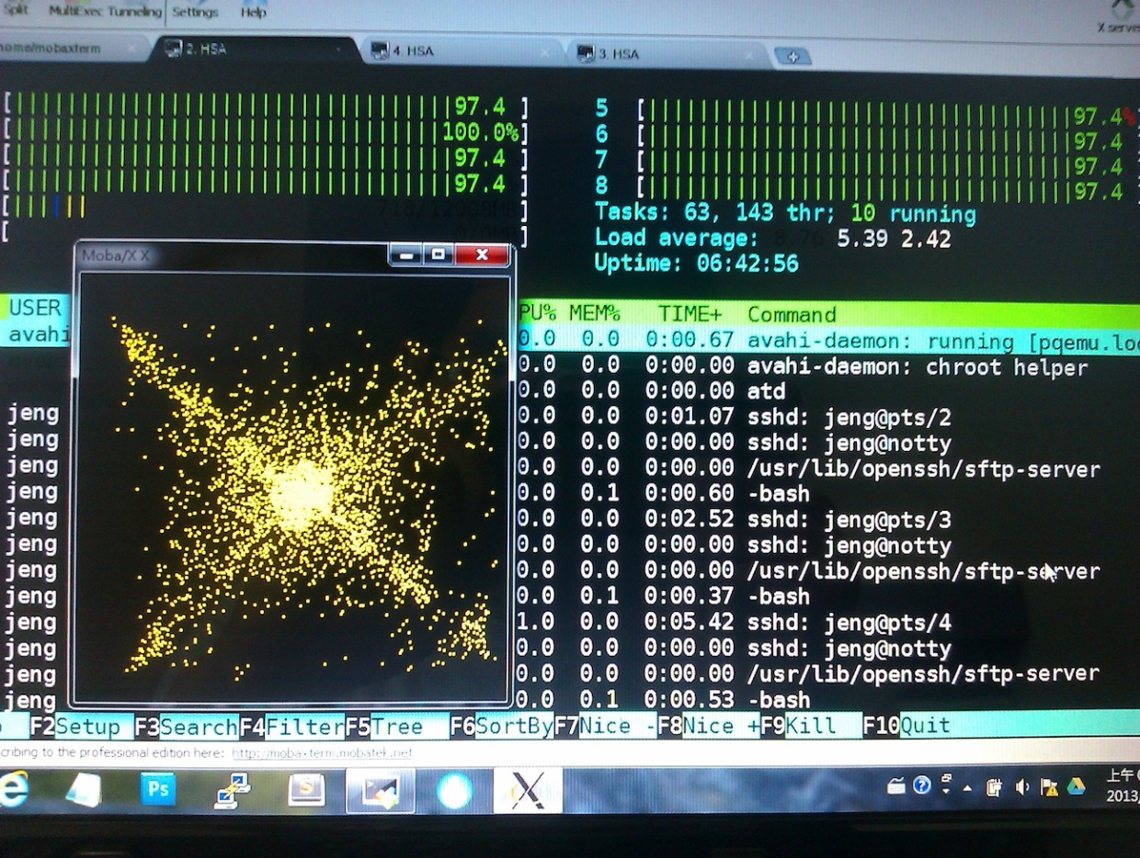
N-Body Simulation by Fast-GPU Simulator
N-Body Simulation
All of host physical CPUs are running

Slide 75
Reference
rednoah“VM & QEM”2010/04/09
徐慰中 “Introduction to Virtual Machines
and Virtualization Technology” 2012/09/17
臧傑晧 “Introduction to VM” 2012/07/26
郭舟東 “QEMU” 2012/07/25
陳韋任 “qemu - 韋任的維基百科” http://people.cs.nctu.edu.tw/~chenwj/dokuwiki/doku.php?id=qemu

